Slide 1
Fast labeling of notes in music signals
Paul M. Brossier, Juan P. Bello, Mark D. Plumbley
Queen Mary College, University of London
Ana Bagić
Notes:
Hello, today I will have a presentation on the paper that I read with the topic of "Fast labeling of notes in music signals".

Slide 2
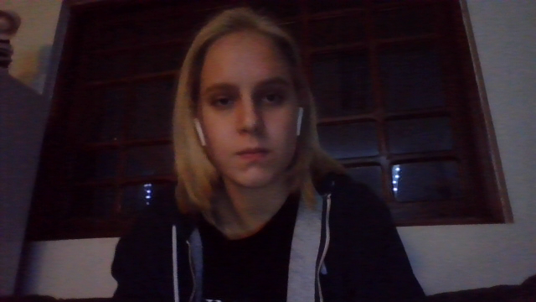
Summary
About
Recap
​System overview
Evaluation
Results
Notes:
This is the summary of todays presentation: first I will give the motivation for this paper and its main points. Then I will give a quick recap of important terms., and after that, a system overview, evaluation technique and obtained results.

Slide 3
About this paper
real time estimation of note attributes (onset and fundamental frequency estimation) from monophonic music source
focus on the behaviour of the system rather that f0 estimation
audio coding, score following, live content-based processing of music data
Notes:
The real-time segmentation and attribute estimation of musical notes is an important field used in a lot of music-oriented tasks such as audio coding, score following and live content-based processing of music data. This paper focuses on real time estimation of note attributes from monophonic music source. The attributes in question are onset time and pitch of the notes. So, it is based on the temporal segmentation and successive estimation of the fundamental frequency.
This system is meant to be used for estimation in real time because of the short time delay and with no previous knowledge of the signal. Aim is to create a robust algorithm that can work with large variety of music signals and in various environments. In this paper focus is on the behaviour of the system rather that fundamental frequency estimation itself, and will tackle different issues of the note detection precision.

Slide 4
RECAP
ONSET
Fundamental frequency f0
MONOPHONIC SOURCE
beginning of a note
lowest frequency of a harmonic sound - partials at frequencies which are multiples of f0
strongly related to pitch
melody without accompanying harmony or chords
pitch detection algorithm - extension to polyphonic signal
Notes:
Before I explain the system, I want to give a brief recap of some important terms for this paper. The first one is onset. This is simply the time that the note starts.
The second one is fundamental frequency, also denoted as f0. This is the lowest frequency of a harmonic sounds and its partials appear at frequencies which are multiples of fundamental frequency. For most sounds the fundamental frequency is strongly related to our concept of pitch.
And the last one is monophonic music source. This is a melody without accompanying harmony or chords. Although this paper is focused on monophonic sounds, choice of pitch detection algorithm is driven towards the extension to polyphonic signal.

Slide 5
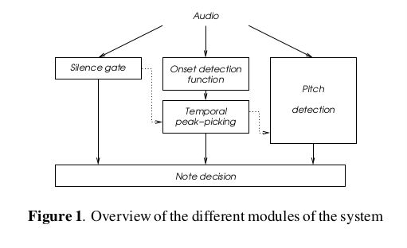
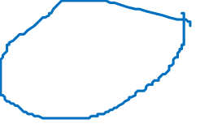
System overview
Notes:
On this photo you can see the system overview and its main components. Two phase vocoders are used in parallel for both onset and pitch detection, and Short Time Fourier Transform is calculated.
The first component is the silence gate, used to supress spurious candidates in background noise. What that means is that when signal drops under certain threshold, the onsets are discarded.

Slide 6
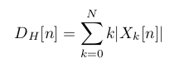
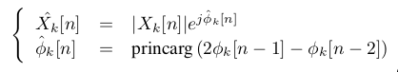
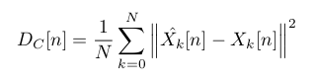

Onset detection
High frequency content
Complex domain approach
Very precise for percussive onsets
Precise for tonal onsets, but over detects percussive ones
Changes in both energy and phase
Notes:
The second one is onset detection. It consists of a construction of a detection function derived from one or a few consecutive spectral frames of a phase vocoder. The detection function increases at the beginning of the note attack, and afterward peak-picking is required to select only the relevant onsets.
Different detection functions are explored but these two showed the best results.
First one is simple and very effective called High Frequency Content and it can be derived from one spectral frame. It precisely identifies percussive onsets, but is less precise for non-percussive ones.
The second one is complex-domain approach. It can cope with the harmonic changes of low transient timbres and a target Short Time Fourier Transform is calculated as is shown in this photo. It allows for the detection function to be calculated as shown in the picture below. Because it looks for changes at both energy and phase, it is good for tonal onsets. However, it tends to over detect percussive events.

Slide 7
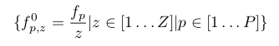
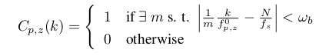
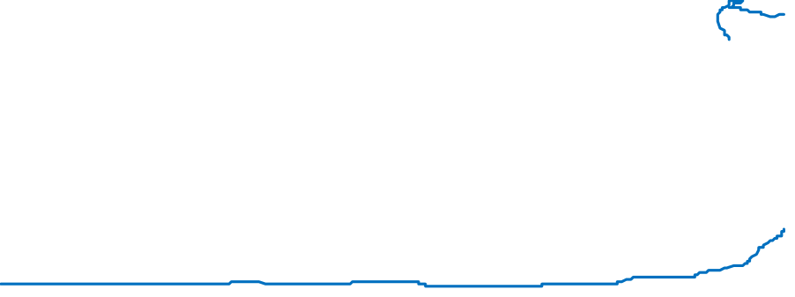
Pitch estimation
Window of typically 4096 samples
Longer window –> longer delay
Notes:
The pitch detection algorithm is based on the spectral frames of a phase vocoder similar as in onset detection functions. Window of a phase vocoder typically consists of 4096 samples, and overlap rate is the same as in onset detection function. Longer window implies a longer delay in the system, but is required for accurate frequency estimation.
Peaks are detected in the magnitude spectral frame and passed to harmonic comb. Each of the P highest peaks generates a set of pitch hypothesis defined by the first Z sub-harmonics shown in the first picture, but for monophonic signals we will limit to P equals 1. For each of these hypothesis a harmonic grid is constructed as shown below.

Slide 8
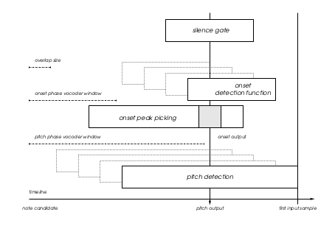
Note decision
Notes:
The data from different modules is ordered carefully. This paper relies on the temporal onset detection and looks for note pitches over the frames past each onset. Because of the different window sizes, synchronization between the pitch candidates and the onset time is required and that is shown on this picture. Pitch detection is performed a few frames after the onset time because the attack of the note covers most of the harmonic components. Pitch is calculated as a median over the candidates of frames that appear after the previously explained chosen offset.

Slide 9
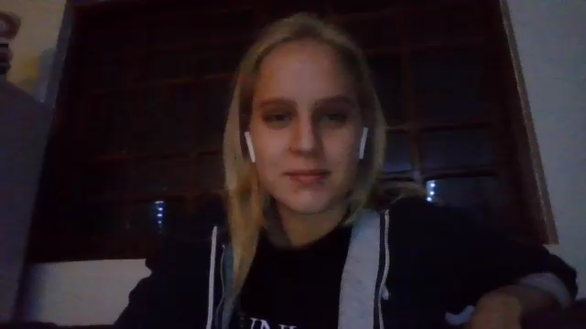
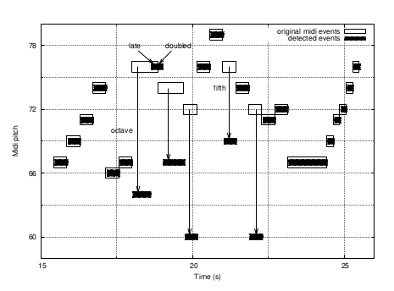

evaluation
Audio waveforms generated using MIDI files (Timidity++)
Main program processes the waveform and stores a list of note candidates
Python code to compare original notes to detected ones
Notes:
For the evaluation purposes, audio waveforms are generated using MIDI files of various single voiced instrument tracks. MIDI files are converted into raw waveforms using Timidity++ software. After that, the main program is called to process the waveform and store the note candidates in a list. A Python script is then used to compare the original list to the list of detected events.
If the detected note corresponds to a real one within a tolerance window of length eta and correct MIDI pitch, then it's correct. Some errors can be seen in this photo. The original notes are in solid lines, and detected in black squares. Errors can be either a frequency error (which is usually octave of fifth jump), or temporal error (doubled or late detections).

Slide 10
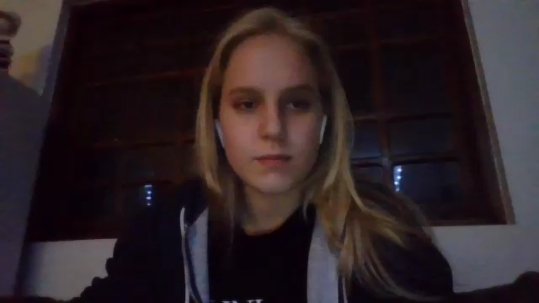
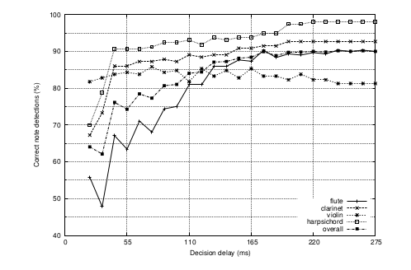
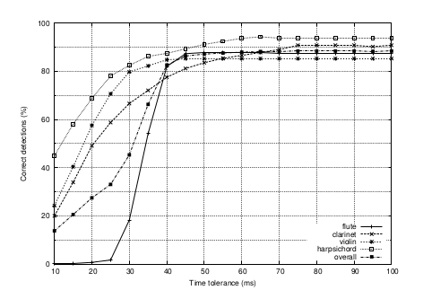

RESULTs
Best performance: product of HFC and complex domain onset functions
Notes:
The conclusion of this paper was that the best results are obtained when both decision functions earlier mentioned (High Frequency Content and complex domain onset function) are used together as a product. In the left photo we can see the correct note estimation results for different values of delta Delta is the number of frames considered for calculating pitch in the note decision process earlier explained. Various instruments were tested such as flute, violin, clarinet and harpsichord.
We can see that harpsichord (marked with empty squares) is usually successfuly labeled with low amount of frames. On the other hand, flute (marked with pluses) takes more frames because of the soft and breathy attack of the note played on flute.
The right photo shows percentage of correct decisions regarding time. It is measured with a fixed value of 15 frames, and variable time tolerance window. We can see that within 50ms system reaches an optimal score alignment. Once again, harpsichord reaches best results in small window, and flute the worst (especially if it's under 30ms).

Slide 11
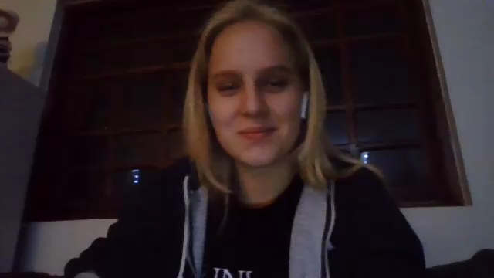
Questions?
Notes:
If I were in class now, I would ask for questions, but since I'm not this is the end of the presentation.

